Slide 1

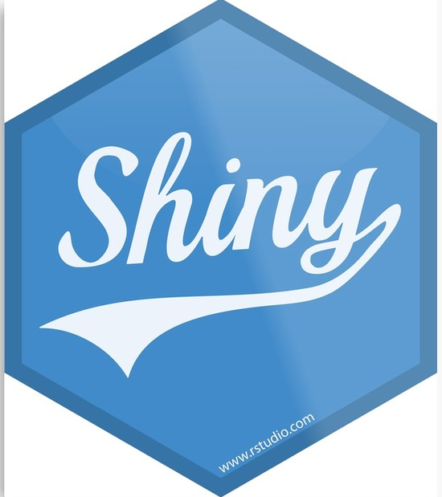
Book Recommendation App
Are you still deciding next book to read?
Team: Boiler Google R
Wenhan Yan, Haowei Lai, Yuchen Li, Chunxuan Zhang
Source: https://techrocks.ru/2019/03/10/frameworks-and-libraries-difference/

Slide 2





Boiler Google R
Chunxuan Zhang
MS BAIM
Yuchen Li
MS BAIM
Wenhan Yan
MS Economics
Haowei Lai
MS GSCM
Boiler Google R
Book Recommendation App
2

Slide 3

Business Scenario
Bookstores found out that it is hard to help customers look for books that with high quality and less popularity base on traditional marketing methods.
A book recommender may help people to get out of box recommendations on minority books, and it also could help bookstore expand their market in minority books.
How we can successfully recommend people books that they would have interests?
Aside from sorting and searching books in different genres or features, we are also able to compare our users to other similar users by reading their rating behaviors.
Boiler Google R
Book Recommendation App
3

Slide 4
Problem Statement
Issues to Resolve
1
2
2
Find similar users
Generate Recommendation Books
What is common in books preference
What is the similarity in their Rating
Recommend books in Ranking list
Provide overview of each book contents

Slide 5




Collaborative Filtering
Identify the App user
Rating score from similar users for other books
Make Predictions base on similarity prediction model
Rating correlation coefficient between current user and similar users
Provide user books
on
similarities and rating ranks
Find Similar Users rated
same books
Source: https://www.kaggle.com/philippsp/book-recommender-collaborative-filtering-shiny
Boiler Google R
Book Recommendation App
5
Notes:
Most Popular Method for product recommendation
Identify the app user to other similar users in the dataset
Sort users who rated exactly same or similar set of books
Check out other similar users' rating for other books
Average rating for one book
Rating correlation coefficient
Provide books with highest ratings to the app user
Making predictions base on our model

Slide 6





Search Books with App
Enter 3 books’ name in text input box
Provides the detail of books user rated
Rate these books
App provide recommendations
App provides search reasults and overview of contents
Boiler Google R
Book Recommendation App
6
Notes:
App user enter the name of book they have read in text input box
App user rate these books
App provide recommendations
Or
App user enter book name they may want to know contents overview
App automatically provide searching reasults and overview of contents

Slide 7
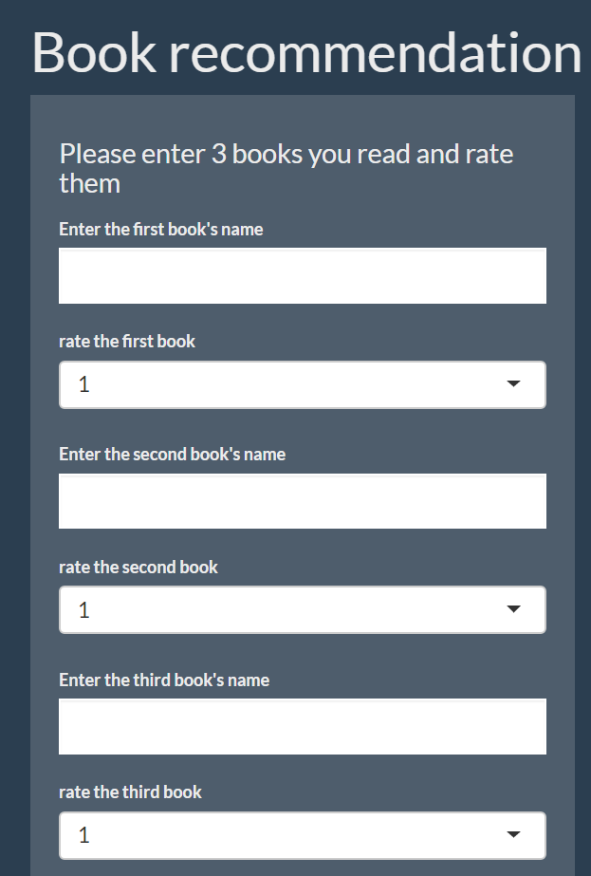
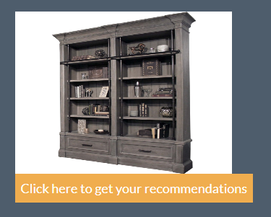

App Demonstration
Enter the book name you want to rate
Select your rate for books
Click this button for recommendation
GitHub Access
Boiler Google R
Book Recommendation App
7
Notes:
Let's test books with The Great Gatsby, The Hobbit, The Catcher in the Rye
Rating as 4,4,5

Slide 8
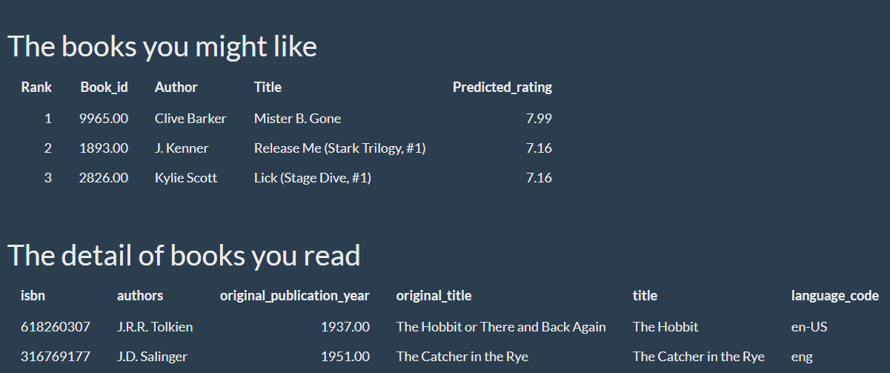
App Demonstration
The detail of recommendations and detail of books you search for
Boiler Google R
Book Recommendation App
8

Slide 9
Future & Summary
Summary
Business Scenario
Project Statement
App Demonstration
Future Development
Book img
Add purchase url
Boiler Google R
Book Recommendation App
9

Slide 10
Reference
Data:
https://www.kaggle.com/zygmunt/goodbooks-10k
Referenced Project: https://github.com/pspachtholz/BookRecommender/blob/master/ui.R
Boiler Google R
Book Recommendation App
8

Slide 11

Thank You
Team: Boiler Google R
Wenhan Yan, Haowei Lai, Yuchen Li, Chunxuan Zhang
Source: https://techrocks.ru/2019/03/10/frameworks-and-libraries-difference/

